Slide 1
“consistency, clarity, simplification and continuous maintenance”
COUNTER Release 5 Code of Practice
UKSG: Thursday 13 July 2017

Slide 2
Why COUNTER Release 5
Current Code of Practice is complex
Inconsistencies in reports, metric types and formats
Needs have evolved and continue to evolve

Slide 3
Objective for Release 5
Seek the balance between addressing changing needs and reducing the complexity of the Code of Practice to ensure that all publishers and content providers are able to achieve compliance
Notes:
A main goal of Release 5 is to balance changing reporting needs with the need to make things simpler so that all content providers can achieve compliance and librarians can have usage statistics that is credible, consistent and comparable.

Slide 4
Four Master Reports
Platform Master Report
Database Master Report
Title Master Report
Item Master Report
Notes:
In rethinking reporting for R5 we have introduced four “Master Reports” – one for each level in which usage is reported. Librarians will be able to use Master Report to customize their analysis to meet their specific reporting need.

Slide 5
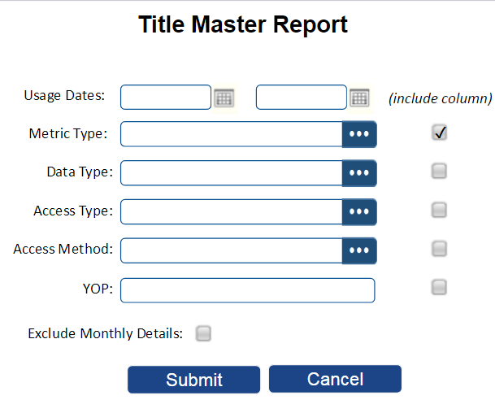
Master Reports can be Filtered and Configured to Tailor Analysis
For illustrative purposes only
Notes:
Here is a mock-up of a reporting interface (for illustrative purposes only) in which the library staff would be able to report on title level usage by picking which metric types to show, limit to certain data types (e.g. books or journals) decide if they want usage for material under subscription (Access Type = Controlled), Gold Open Access or both; and be able to select a range of Year’s of publication.

Slide 6
“Standard Views”
Platform Master Report
Platform Usage
Database Master Report
Database Search and Item Usage
Database Access Denied
Title Master Report
Book Requests (Excluding OA_Gold)
Book Access Denied
Book Usage by Access Type
Journal Requests (Excluding OA_Gold)
Journal Access Denied
Journal Usage by Access Type
Journal Requests by YOP (Excluding OA_Gold)
Item Master Report
Journal Article Requests
Multimedia Item Requests
Notes:
While flexibility is great, it does offer challenges when comparability is desired; therefore, R5 goes further to define a series of “standard views” on the Master Reports. Standard Views address common use cases and are essentially a set of pre-defined attributes and filters for the corresponding Master Report.

Slide 7
Analyze database performance with searches, and activity related to abstracts and full text
Platform Master Report
Platform Usage
Database Master Report
Database Search and Item Usage
Database Access Denied
Title Master Report
Book Requests (Excluding OA_Gold)
Book Access Denied
Book Usage by Access Type
Journal Requests (Excluding OA_Gold)
Journal Access Denied
Journal Usage by Access Type
Journal Requests by YOP (Excluding OA_Gold)
Item Master Report
Journal Article Requests
Multimedia Item Requests
“Standard Views” Address the Most Common Use Cases

Slide 8
Platform Master Report
Platform Usage
Database Master Report
Database Search and Item Usage
Database Access Denied
Title Master Report
Book Requests (Excluding OA_Gold)
Book Access Denied
Book Usage by Access Type
Journal Requests (Excluding OA_Gold)
Journal Access Denied
Journal Usage by Access Type
Journal Requests by YOP (Excluding OA_Gold)
Item Master Report
Journal Article Requests
Multimedia Item Requests
Comparable usage of acquired books, regardless of how those books are delivered.
“Standard Views” Address the Most Common Use Cases

Slide 9
Usage for subscribed journals supporting cost-per-use analysis
Platform Master Report
Platform Usage
Database Master Report
Database Search and Item Usage
Database Access Denied
Title Master Report
Book Requests (Excluding OA_Gold)
Book Access Denied
Book Usage by Access Type
Journal Requests (Excluding OA_Gold)
Journal Access Denied
Journal Usage by Access Type
Journal Requests by YOP (Excluding OA_Gold)
Item Master Report
Journal Article Requests
Multimedia Item Requests
“Standard Views” Address the Most Common Use Cases

Slide 10
Platform Master Report
Platform Usage
Database Master Report
Database Search and Item Usage
Database Access Denied
Title Master Report
Book Requests (Excluding OA_Gold)
Book Access Denied
Book Usage by Access Type
Journal Requests (Excluding OA_Gold)
Journal Access Denied
Journal Usage by Access Type
Journal Requests by YOP (Excluding OA_Gold)
Item Master Report
Journal Article Requests
Multimedia Item Requests
“Standard Views” Address the Most Common Use Cases
A closer look at subscribed journal usage for analysis by YOP

Slide 11
Platform Master Report
Platform Usage
Database Master Report
Database Search and Item Usage
Database Access Denied
Title Master Report
Book Requests (Excluding OA_Gold)
Book Access Denied
Book Usage by Access Type
Journal Requests (Excluding OA_Gold)
Journal Access Denied
Journal Usage by Access Type
Journal Requests by YOP (Excluding OA_Gold)
Item Master Report
Journal Article Requests
Multimedia Item Requests
“Standard Views” Address the Most Common Use Cases
Analyze usage of multimedia content at the item level.

Slide 12
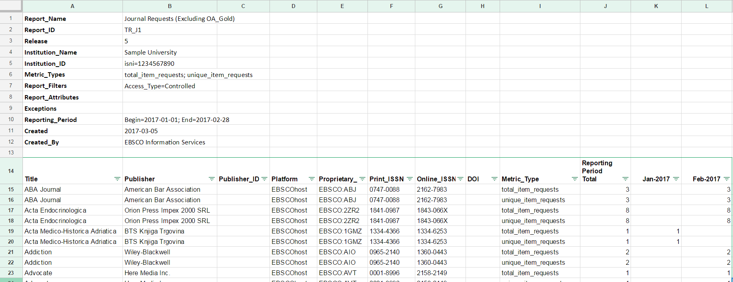
Example of a Standard View for the Title Master Report
Notes:
Here we have the Standard View “Journal Requests (Excluding OA_Gold)

Slide 13
R5’s Simplified Metric Types & Related Attributes
Simplicity and Clarity
Notes:
Lets talk about metric types and related attributes

Slide 14
COUNTER Release 5: Metric Types
Release 4
abstract | no_license
audio | other
data_set | podcast
ft_epub | record_view
ft_html | reference
ft_html_mobile | result_click
ft_pdf | search_fed
ft_pdf_mobile | search_reg
ft_ps | sectioned_html
ft_ps_mobile | toc
ft_total | turnaway
image | video
multimedia
Release 5
total_item_investigations
total_item_requests
unique_item_investigations
unique_item_requests unique_title_investigations unique_title_requests
searches_regular
searches_federated
searches_automated
searches_platform
no_license
limit_exceeded
Item
Database
Platform
Item
25 metric types in R4 reduced to 12 in R5.
Format-specific metrics eliminated!
Notes:
Lets talk metric types. COUNTER R4 metric types are on the left and Release 5 on the right. We have eliminated format-specific metrics and reduced the number of metric types by half.

Slide 15
COUNTER Release 5: Metric Types
Investigations versus Requests…
Release
total_item_investigations
total_item_requests
unique_item_investigations
unique_item_requests unique_title_investigations unique_title_requests
searches_regular
searches_federated
searches_automated
searches_platform
no_license
limit_exceeded
User Action
View abstract
Link to Link Resolver
Item
View cited references
Investigations
Link to ILL form
View HTML full text
Database
Requests
View PDF
Platform
View content…
Item
View article preview
Notes:
We are introducing a new vocabulary as well since we need metric types to be format-agnostic – i.e. A video is not “text” so full text is not appropriate. “Investigations” is a superset metric in that it counts all activity a user has for an item where an item is the unit of content accessed – ie. Article, chapter, etc. Users viewing a detailed record, clicking an OpenURL link, viewing the full text, are all considered “investigations”… Another way of looking at it is that “investigations” are an overall measure of the user’s interest in a content item.
Metrics include total item investigations… plus unique_item investigations in which an article or chapter can only get credit for one action in a user session; and, unique title investigations – which applies mostly to books – where the title, or book gets only credit for one unique_title_investigation in a user session… This resolves the incompatibility between book report 1 and book report 2 in that it no longer matters how the book is delivered.

Slide 16
Susan is researching on Publisher Platform.
From a list of search results, she opens three article abstracts and a video record. All four records are different, but two of the articles are from the same journal. The counts are:
Total_Item_Investigations: 4
Unique_Item_Investigations: 4
Unique_Title_Investigations: 3
After reading the abstracts, Susan downloads the PDFs for two of the articles, both from the same journal. The counts change to:
Total_Item_Investigations: 6
Unique_Item_Investigations: 4
Unique_Title_Investigations: 3
Total_Item_Requests: 2
Unique_Item_Requests: 2
Unique_Title_Requests: 1
SCENARIO

Slide 17
Additional Attributes
Data Type
Section Type
Access Type
Access Method
Year of Publication (YOP)
These can be used in combination to break out usage details
Notes:
In order to offer the flexibility and depth or reporting, COUNTER R5 introduces a series of additional attributes that can be combined with the simplified set of metric types.

Slide 18
COUNTER Release 5: Data Types
Data_Type identifies the general type of content being accessed or for which usage is being reported.
This attribute is used when creating Standard Views for Books and Journals and is an optional parameter for the Title Master Report and can be used to generate summaries in a Database Master Report or Platform Master Report.
Data_Type
Article Book Book Segment Database Dataset Journal Multimedia Newspaper or Newsletter Platform Other Repository Item Report Thesis or Dissertation
Notes:
Data types are captured to reflect the nature of the material being used.

Slide 19
COUNTER Release 5: Section Types
Section_Type when content is delivered in “chunks” (sections) this describes what that section is, e.g. a book may be accessed by the chapter; content in a journal is accessed by article.
This attribute is an optional parameter for the Title Master Report.
Section_Type
Article Book Chapter Other Section
Notes:
Section type helps with measuring book usage by indicating if the unit of content delivered as an article, chapter, section or the entire book.

Slide 20
COUNTER Release 5: Access Types
Access_Type describes the nature of access control that was in place when the content item was accessed.
This attribute is in filtering for Standard Views and Master Reports and is included in Book Usage by Access Type and Journal Usage by Access Type Standard Views. It’s primary role is to differential usage of gold open access content from content that requires a license.
OA_Delayed is content that became open access after an embargo period had expired.
Access_Type
Controlled OA_Delayed* (reserved for future use) OA_Gold Other_Free_to_Read (repositories only)
* OA_Delayed is NOT part of the initial release of R5. It will be introduced at a future date (with sufficient advance notice) after further study.
Notes:
Access types relate to the access control that was in place when the content was requested. Controlled means a license was required; OA_Gold means the content as available as Open Access because an article processing charge was paid; OA_Delayed is for content that became open access after an embargo period… Note that OA_Delayed will not be introduced until some future date.

Slide 21
COUNTER Release 5: Access Methods
Access_Method is an attribute indicating whether the usage related to investigations and requests was generated by a human user browsing and searching a website (“regular”) or by Text and Data Mining processes (TDM).
This attribute appears as an optional parameter the Master Reports.
TDM usage is excluded from the standard views for Journal and Book usage.
Access_Method
Regular TDM
Notes:
Access Method was introduced to track regular usage separately from usage for the purpose of text and data mining. The latter may results in massive amounts of content being accessed and it can skew the stats. Separating this activity allow TDM usage to be measured and still be kept separate from regular usage.

Slide 22
COUNTER Release 5: Year of Publication
YOP is the year of publication for the content item accessed. If content is available in print and online format and the publication dates of these two formats differ, the year of publication of version of record (normally the format that is published first) is used.
YOP is an option attribute in Title Master Report, Database Master Report and Platform Master Report. It appears as a column in the Journal Requests by YOP (Excluding OA_Gold) Standard View.
YOP
yyyy 0001 (unknown) 9999 (articles in press)
Notes:
And, Year of Publication is captured as an attribute to allow more flexible reporting that what was offered in Journal Report 5.

Slide 23
R5’s Simplified Report Formats
Simplicity and Clarity
Notes:
Lets talk about metric types and related attributes

Slide 24
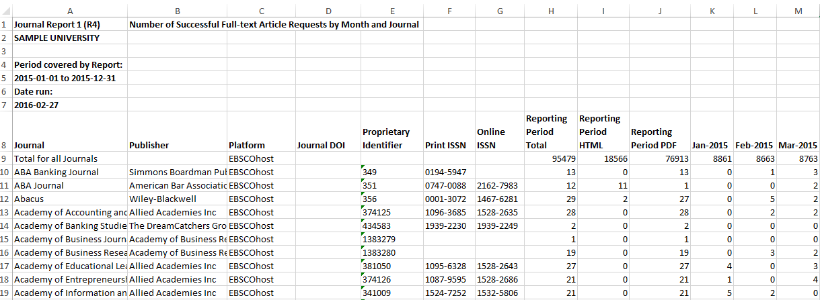
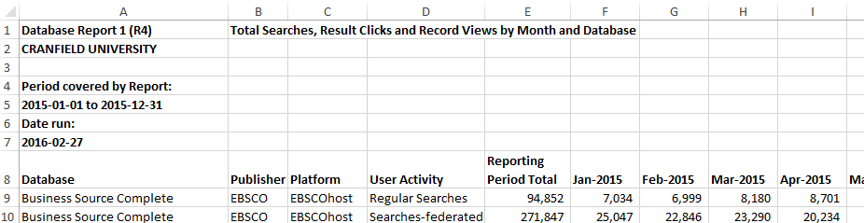
COUNTER Release 4: Report Formats
Excel version of Journal Report 1 has totals for PDF and HTML, XML version breaks them out by month
Database Report breaks out usage by metric type. Journal (and book) reports don’t.
Notes:
I Journal Report 1, HTML and PDF usage is broken out, but only as totals… the SUSHI version has these figures broken out by month.

Slide 25
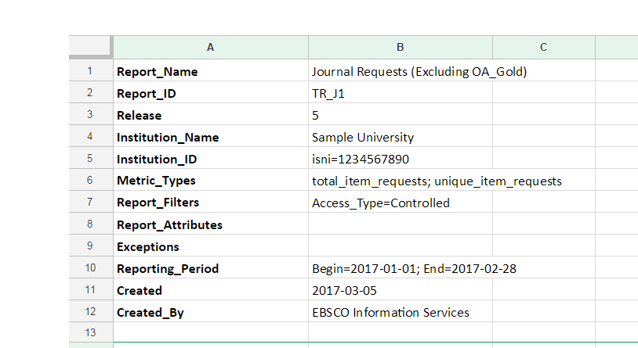
COUNTER Release 5: Report Formats
Consistent Header
Notes:
The headers for all reports would have the same exact format; and, this same information would appear in the SUSHI version. Yes, there are more rows, but this makes the report clearer and easier to process. Plus a blank row was added before the body of the report to make it easy add filtering and sorting in Excel and Google Sheets.

Slide 26
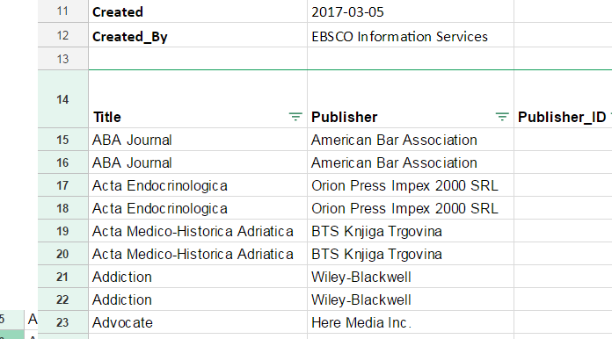
COUNTER Release 5: Report Formats
Consistent Detail
Notes:
The details of the report are consistent across reports. While not all reports will have all the same column headings, when they do, the labels and column order will be consistent across reports.

Slide 27
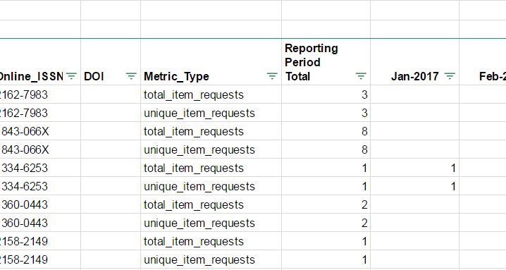
COUNTER Release 5: Report Formats
Consistent Vocabulary
Notes:
The terminology used in reports is the same across reports and between the tabular and SUSHI version.

Slide 28
COUNTER_SUSHI for Release 5
RESTful interface returning JSON-formatted reports
Familiar to most web developers
Allows retrieval of full reports, or snippets of usage
Allows usage display to be embedded in other applications
Notes:
In release 5, the next version of SUSHI will be supported -- one which adopts a RESTful interface returning JSON-formatted usage.
This is in line with modern web development; using approaches that are familiar to most web developers. And it offers a microservice approach that allows usage to be embedded in other applications.

Slide 29
Addressing Community Feedback on Draft 1
Notes:
In this next section we will discuss some of the changes that were made to the initial draft of the R5 of the CoP. We received a lot of valuable feedback from all stakeholders. There were definitely some issues with the initial draft that would have made R5 very difficult to implement – we made several simplifications to address these issues.

Slide 30
Amendments to Draft 1 to remove implementation challenges
Is_Archive has be eliminated
OA_Gold_APC and OA_Gold_Non_APC have be eliminated in favor of “OA_Gold”
Other_Free_To_Read will not apply to publishers (only Repositories).
OA_Delayed will listed in R5 but designated as "reserved for future use"
Standard Views specifically focused on library use cases have been introduced to address the potential that reports will be longer.

Slide 31
Draft 2 includes additional clarification and guidance
The new metrics Investigations and Requests were a source of confusion and have been clarified with graphics and explanatory text.
Concern about HTML and PDF and the transition from R4 to R5 have been addressed through the inclusion of a section in the CoP that specifically addresses this issue and provide a mapping of R4 metrics and the R5 equivalents

Slide 32
Things we cannot directly address
Sessions
  modern interfaces make sessions hard to capture and somewhat inconsistent in their interpretation.
Output the report header to a separate tab
  When reports are downloaded as TSV, there are no tabs
  R5 reports have a blank row before the report body to making sorting and filtering operations and generating pivot tables painless (the header is not an issue)
  Excel and Google Sheets allows users to “Freeze” the header row to make it easy to compensate

Slide 33
New approaches
Concerns about no reporting of zero usage
  Not all publishers produce their COUNTER statistics from the same system they use to manage their access control
  COUNTER is being represented on a new NISO initiative, currently referred to as KBART-Automation for SUSHI harvesting of BOTH usage and entitlements
R4’s Journal Title Report 5 considered as critical for library decision-making
  The “Journal Requests (Non-Gold OA) by YOP” standard view provides the same information but with greater detail.

Slide 34
New approaches
Consortium Reports as Separate Reports
  Due to size, creating and consuming R4 consortium reports was not always possible
  Methods included in R5 simplify the retrieval of any R5 report for all consortium members
  COUNTER is committed to facilitate development Open Source tools that will provide consortium administrators with the ability to generating consolidate usage reports for the consortium

Slide 35
Your questions answered … mostly
Benefits to publisher
Maintaining a shared robot filter list
Timeline for implementation. COUNTER5 and how I can compare it to past reports ?
Research data
How COUNTER handles resources that are made up of several products
How often is COUNTER updated?
Any issues with how platforms count usage and Underlying data from which usage stats are generated

Slide 36
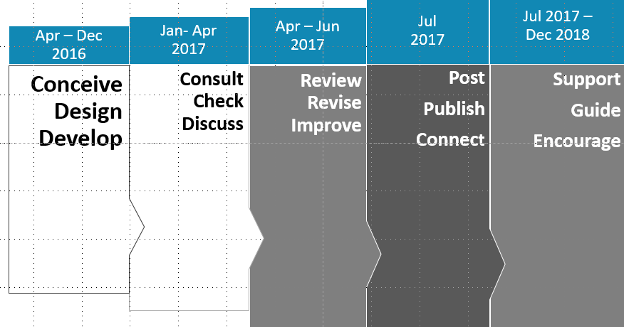
Project Timeline
Jan 2019

Slide 37
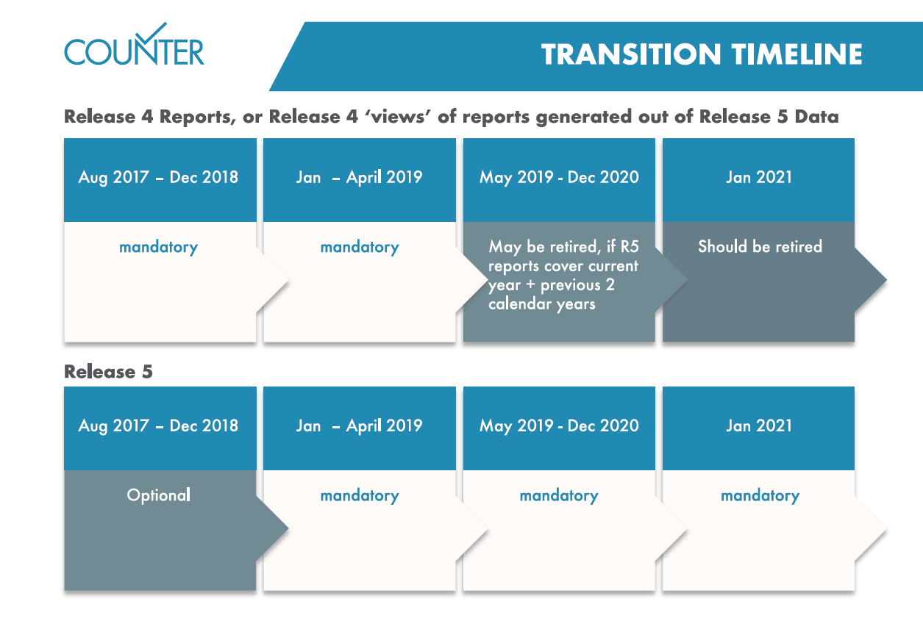
Transition

Slide 38
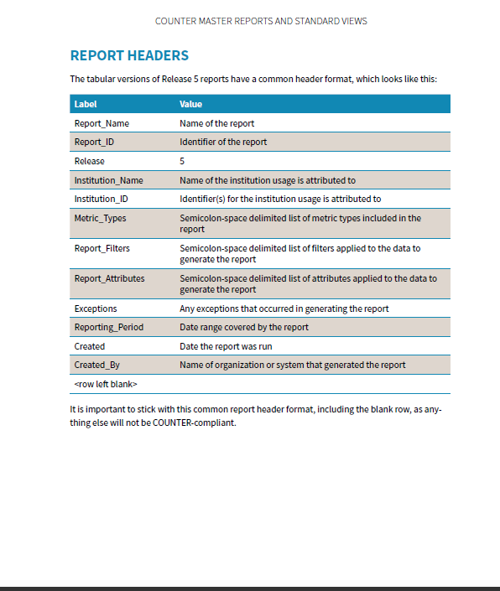
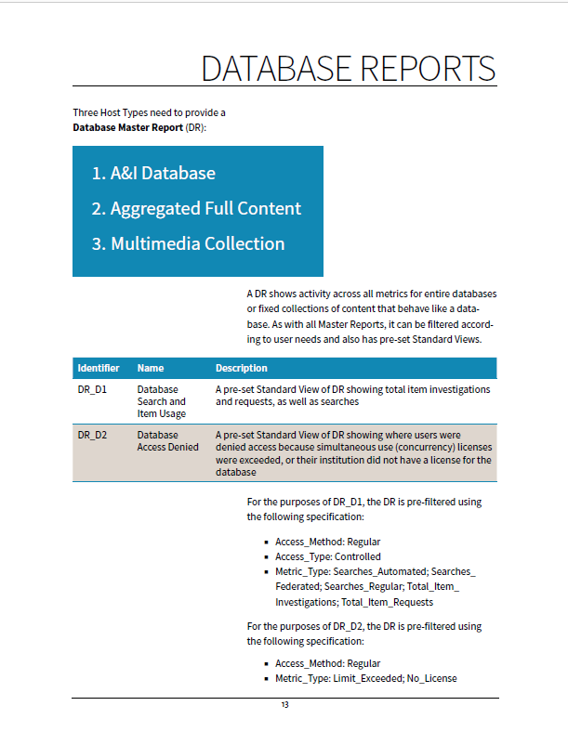
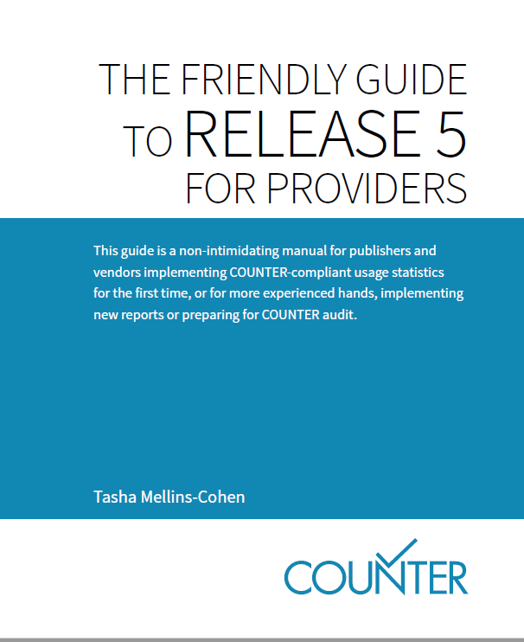
Support
Transition timeline
Webinars
Guides
Email forum for Release 5 implementers

Slide 39


Draft 2 of Release 5 Now Available Online https://docs.google.com/document/d/1cgpiMtDcvsm-P_qU2c1xD6JkNyLK5S-O7bPc-Wh8JCs/
Lorraine Estelle lorraine.estelle@counterusage.org
http://www.usus.org.uk/
Notes:
Here is a link to a site where you can get access to the draft code of practice. Please review, and please provide feedback – hearing from the community that creates and uses COUNTER reports is important.

